Slide 1
Detection and Characterization of Fake News through Text Classification
INTRNLP
Manay, Justin Gabrielle

Slide 2
Objectives
To employ typical features and methods (term frequency/TF-IDF as features, naïve Bayes and logistic regression as classifiers) to distinguish fake news from real news
To extract linguistic features to characterize the difference between real news and fake news
To employ these features in addition to those used previously to improve model accuracy

Slide 3
Outline
DATA DESCRIPTION
PRE-PROCESSING
BASELINE MODEL FITTING
FEATURE EXTRACTION
FEATURE SELECTION
FINAL MODEL FITTING

Slide 4
Outline
DATA DESCRIPTION
PRE-PROCESSING
BASELINE MODEL FITTING
FEATURE EXTRACTION
FEATURE SELECTION
FINAL MODEL FITTING

Slide 5
Data Description
fake news from BS Detector dataset (source: https://www.kaggle.com/mrisdal/fake-news), consisting of news articles whose sources had been deemed as BS by the BS Detector Chrome Extension
real news from All the news dataset (source: https://www.kaggle.com/snapcrack/all-the-news), consisting of digital and print articles from 15 mainstream publications

Slide 6
Cleaning Procedures
kept real articles published within 5 days from the earliest/latest publication dates in the fake news dataset (for balancing purposes)
removed Breitbart articles from the real news dataset.
dropped all articles not in English
dropped articles with less than 200 words
extracted only the relevant columns
renamed columns from the fake dataset to match column names in the real dataset
placed tags ("real" and "fake")

Slide 7
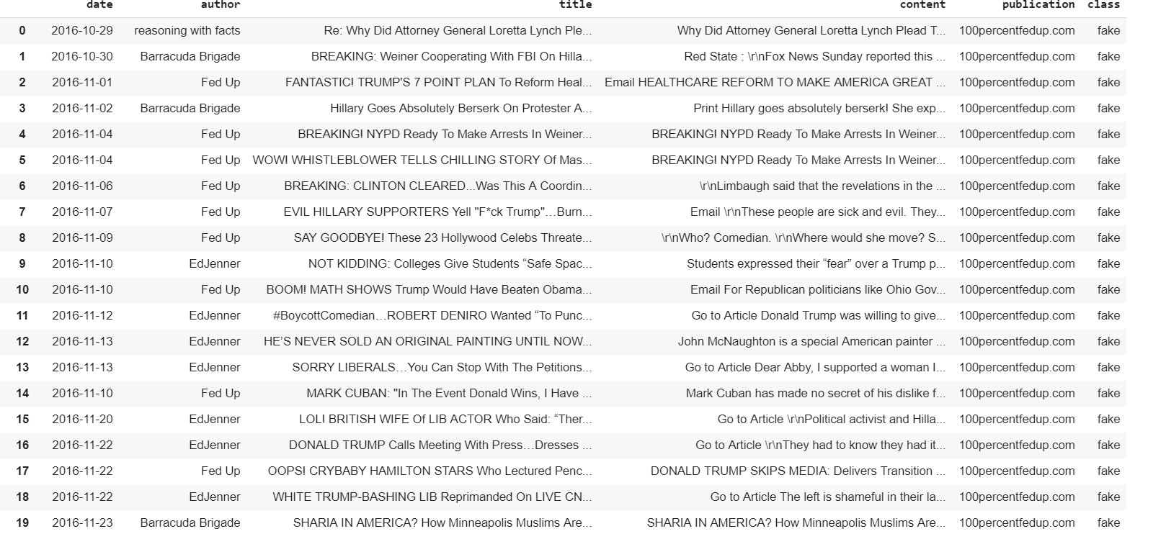
Dataset Snippet

Slide 8
Dataset Snippet

Slide 9
Dataset Snippet

Slide 10
Dataset Snippet

Slide 11
Data Sources
TABLE 1. Data sources
NEWS TYPE | SOURCES
real news | Atlantic, Business Insider, Buzzfeed News, CNN, Fox News, Guardian, NPR, National Review, New York Post, New York Times, Reuters, Talking Points Memo, Vox, Washington Post (14 in total)
fake news | 100percentfedup.com, 21stcenturywire.com, abcnews.com.co, abeldanger.net, abovetopsecret.com, activistpost.com, addictinginfo.org, adobochronicles.com, … (233 in total)

Slide 12
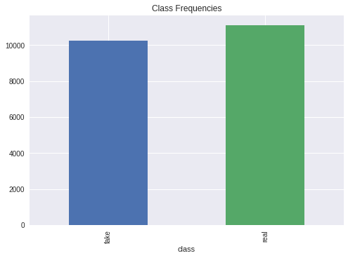

Class Frequencies
FIGURE 1. Class Frequencies

Slide 13
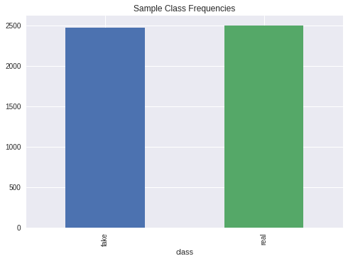

Sample Class Frequencies
FIGURE 2. Class Frequencies after Stratified Sampling

Slide 14
Outline
DATA DESCRIPTION
PRE-PROCESSING
BASELINE MODEL FITTING
FEATURE EXTRACTION
FEATURE SELECTION
FINAL MODEL FITTING

Slide 15
Tokenization
To tokenize, the following are implemented in order:
Remove links.
Remove HTML entities
Expand contractions
Convert % to percent.
Remove numbers.
Match non-unicode text with closest unicode equivalent.
Extract named entities as one token. (e.g., "Donald Trump")

Slide 16
Tokenization
To tokenize, the following are implemented in order:
Stem all words. (toggled when stem = True)
Remove stopwords. (toggled when stop_words = True)
Turn all tokens into lowercase.
Remove punctuation

Slide 17
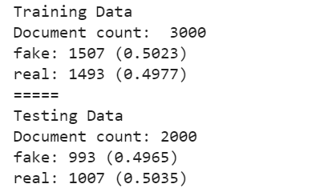
Training/Testing Split
40% of the dataset goes towards the testing set.
stratified sampling

Slide 18
Outline
DATA DESCRIPTION
PRE-PROCESSING
BASELINE MODEL FITTING
FEATURE EXTRACTION
FEATURE SELECTION
FINAL MODEL FITTING

Slide 19

Performance Measures Used
In evaluating the models that follow, we use the accuracy and F1 score, defined as follows:
$$accuracy= \frac{TP+TN}{TP+TN+FP+FN}$$
$$F1 score= \frac{2(Recall ×Precision)}{Recall+Precision}$$
where
$$recall= \frac{TP}{TP+FN}$$
$$precision= \frac{TP}{TP+FP}$$

Slide 20
Term Counts
TABLE 2. Most frequent words based on average term count, after stemming and stop word removal
real news articles | fake news articles
thi wa ha clinton trump hi would peopl one state | wa said trump hi ha thi would one peopl state

Slide 21
Term Counts
We fit a naive Bayes and a logistic regression model. We examine only two variants because the data is large:
without removal of stop words and stemming, unigram
both removal of top words and stemming, bigram

Slide 22
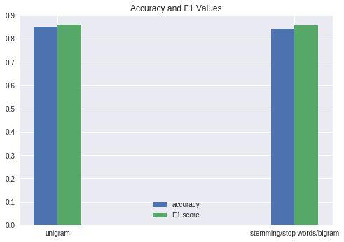
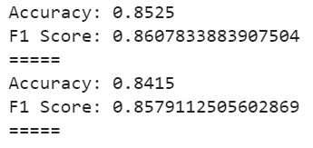
Term Counts
FIGURE 3. Accuracy and F1 values for naïve Bayes (term counts)

Slide 23
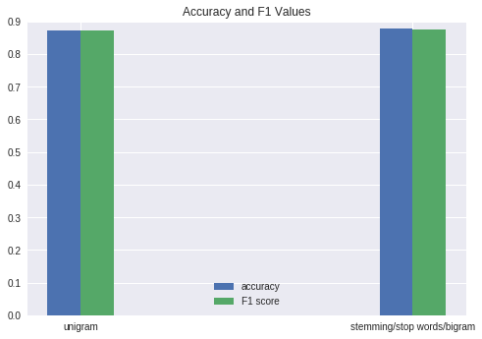
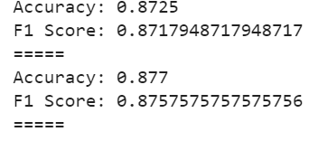
Term Counts
FIGURE 4. Accuracy and F1 values for logistic regression (term counts)

Slide 24
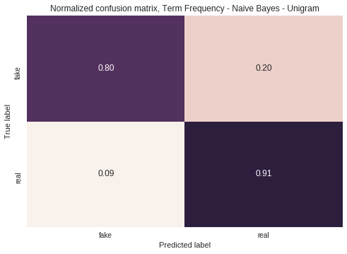
Term Counts
We then examine the best model for each algorithm: naïve Bayes unigram and logistic regression with stemming/stop word removal/bigram.
FIGURE 5. Normalized confusion matrix, naïve Bayes (term counts)

Slide 25
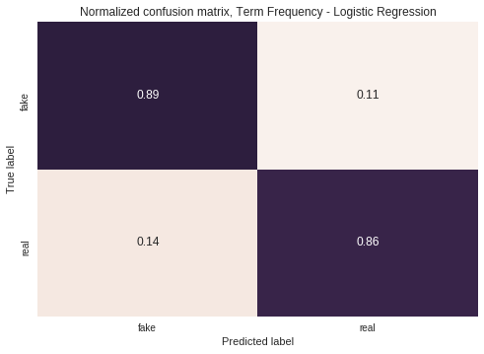
Term Counts
FIGURE 6. Normalized confusion matrix, logistic regression (term counts)

Slide 26
TF-IDF
TABLE 3. Most frequent words based on average TF-IDF weighted frequency, after stemming and stop word removal
real news articles | fake news articles
clinton trump thi wa hillari ha email elect hi us | trump said wa hi ha thi clinton would state elect

Slide 27
TF-IDF
We fit a naive Bayes and a logistic regression model. We examine only two variants because the data is large:
without removal of stop words and stemming, unigram
both removal of top words and stemming, bigram

Slide 28
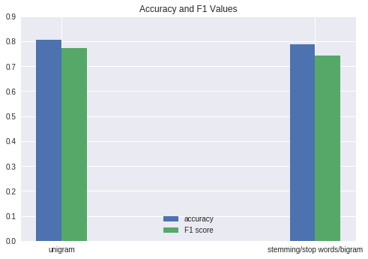
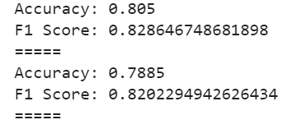
TF-IDF
FIGURE 7. Accuracy and F1 values for naïve Bayes (TF-IDF)

Slide 29
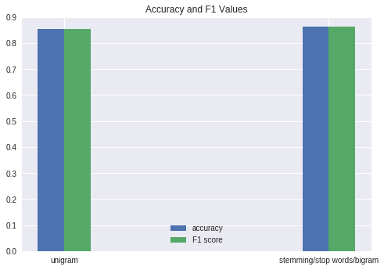
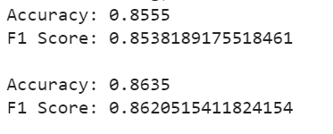
TF-IDF
FIGURE 8. Accuracy and F1 values for logistic regression (TF-IDF)

Slide 30
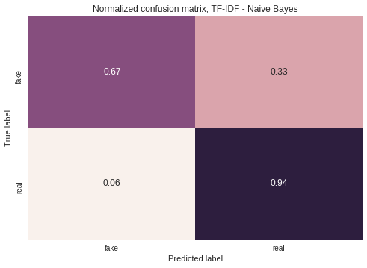
TF-IDF
We then examine the best model for each algorithm: naïve Bayes unigram and logistic regression with stemming/stop word removal/bigram.
FIGURE 9. Normalized confusion matrix, naïve Bayes (TF-IDF)

Slide 31
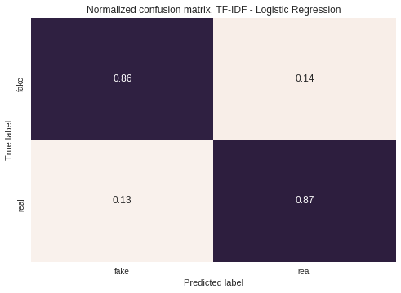
TF-IDF
FIGURE 10. Normalized confusion matrix, logistic regression (TF-IDF)

Slide 32
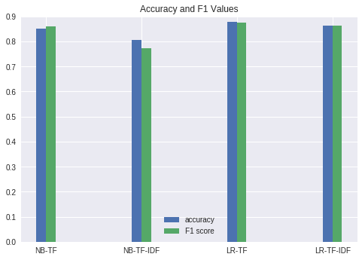
Comparison of Baseline Models
FIGURE 11. All baseline models

Slide 33
Comparison of Baseline Models
Thus, we choose the logistic regression model with term counts that had been pre-processed (i.e., stemming, stop word removal) and had considered bigrams as our baseline model.

Slide 34
Comparison of Baseline Models
RETROSPECTIVE:
Naïve Bayes models performed (relatively) poorly because of slight imbalance in the dataset
FIGURE 12. Comparison of confusion matrices for naïve Bayes and logistic regression (TF-IDF)

Slide 35
Comparison of Baseline Models
RETROSPECTIVE:
TF-IDF models performed (relatively) poorly because terms were not down-weighted as much by the IDF
real news articles (TC) | real news articles (TF-IDF)
thi wa ha clinton trump hi would peopl one state | clinton trump thi wa hillari ha email elect hi us
TABLE 4. Most frequent words in real news articles based on average term counts and TF-IDF weighted frequency, after stemming and stop word removal

Slide 36
Outline
DATA DESCRIPTION
PRE-PROCESSING
BASELINE MODEL FITTING
FEATURE EXTRACTION
FEATURE SELECTION
FINAL MODEL FITTING

Slide 37
Features to be Extracted
Based on Horne and Adali (2017), we extract the following features from the content and title:
Word/Sentence-based Features:
total word count
sentence count
average number of words per sentence
Dale-Chall Readibility Index
type-token ratio
number of stop words
number of punctuation marks

Slide 38
Features to be Extracted
Based on Horne and Adali (2017), we extract the following features from the content and title:
Word/Sentence-based Features:
number of exclamation marks/question marks
number of links
number of words that appear in all capital letters

Slide 39
Features to be Extracted
Based on Horne and Adali (2017), we extract the following features from the content and title:
Part of Speech (POS)-based Features:
number of nouns
number of proper nouns
number of adjectives
number of adverbs
Some other features were left out due to use of paid corpora/tools or out of discretion.
In total, 20 features were extracted per document.

Slide 40

Dale-Chall Readability Index
computed as
gauges how difficult it is to read text. The higher the value, the more difficult it is to understand

Slide 41
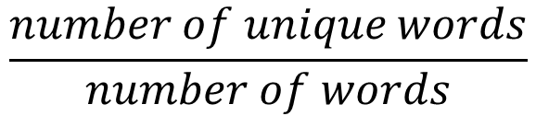
Type-Token Ratio
computed in Horne and Adali (2007) as
said to be a measure of lexical diversity. A lower type-token ratio indicates repetitiveness.
$$\frac{number of unique words}{number of words}$$

Slide 42
Extraction Method
Word and sentence-based features were extracted using the tokenizer function and NLTK.
POS-based features were extracted using SpaCy

Slide 43
Real vs. Fake News
TABLE 5. Word/sentence-based content features comparison (t-test for means)
Features (Content) | Comparison | p-value
word count | Real > Fake | 3.74e-6 **
sentence count | Real > Fake | 2.73e-11 **
words per sentence | Fake > Real | 4.17e-29 **
Dale-Chall readability index | Fake > Real | 1.59e-47 **
type-token ratio | Fake > Real | 5.26e-29 **
stop words | Real > Fake | 3.48e-5 **
punctuation | Real > Fake | 9.10e-5 **
hyperlinks | Fake > Real | 2.08e-91 **
question/exclamation | Fake > Real | 8.02e-10 **
words in all caps | Real > Fake | 0.99

Slide 44
Real vs. Fake News
TABLE 6. Word/sentence-based title features comparison (t-test for means)
Features (Title) | Comparison | p-value
word count | Fake > Real | 1.00e-8 **
stop words | Real > Fake | 0.43
punctuation | Real > Fake | 1.09e-9**
question/exclamation | Fake > Real | 1.08e-9 **
words in all caps | Fake > Real | 2.16e-36 **
Dale-Chall readability index | Fake > Real | 0.012

Slide 45
Real vs. Fake News
TABLE 7. POS-based content features comparison (t-test for means)
Features (Content) | Comparison | p-value
nouns | Real > Fake | 8.46e-9 **
proper nouns | Real > Fake | 0.0048 **
adjectives | Real > Fake | 0.0005 **
adverbs | Real > Fake | 0.0033 **

Slide 46
Real vs. Fake News
Real news tend to have more words and sentences on average.
Fake news have more hyperlinks and question marks/exclamation points on average. They also have less lexical redundancy (lower type-token ratio) and are more difficult to comprehend (higher readability index).

Slide 47
Real vs. Fake News
With respect to titles, fake news articles tend to squeeze as much as possible into the title (larger word count, fewer stop words) and are also more “dramatic” (more words in all-caps, more question marks/exclamation points).
FAKE: HUGE PILE OF MANURE DUMPED IN FRONT OF DEM HQ
REAL: 'Hillary Clinton Liked Covert Action if It Stayed Covert, Transcript Shows - The New York Times'

Slide 48
Outline
DATA DESCRIPTION
PRE-PROCESSING
BASELINE MODEL FITTING
FEATURE EXTRACTION
FEATURE SELECTION
FINAL MODEL FITTING

Slide 49
Feature Selection
Feature selection was done using scikit-learn’s SelectKBest method with the chi2 score function, which implements a chi-squared test of independence.
SelectKBest assigns a score to each feature based on the computed chi-squared statistic. If it is large, the feature and its class (“real” or “fake”) are not independent and will provide important information.
The top 5, 10, 15 and 20 features were selected based on which features had the highest scores.

Slide 50
Top Features
TABLE 8. Top features based on feature selection
Top | Features
Top 5 | word count stop words punctuation hyperlinks nouns
Top 10 | sentence counts words in all caps in title proper nouns adjectives adverbs

Slide 51
Top Features
TABLE 8. Top features based on feature selection
Top | Features
Top 15 | words per sentence Dale-Chall readability question/exclamation word count in title question/exclamation in title
Top 20 | type-token ratio words in all caps stop words in title punctuation in title Dale-Chall readability of title

Slide 52
Outline
DATA DESCRIPTION
PRE-PROCESSING
BASELINE MODEL FITTING
FEATURE EXTRACTION
FEATURE SELECTION
FINAL MODEL FITTING

Slide 53
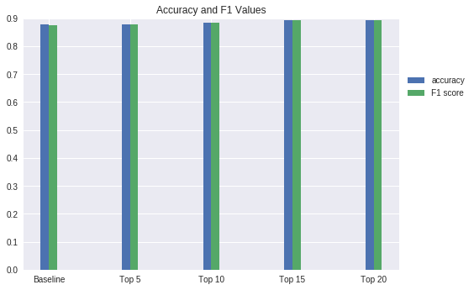
Model Comparison
The best baseline model will be used in addition to the selected features to distinguish real from fake news.
FIGURE 13. Baseline model with selected features

Slide 54
Model Comparison
TABLE 9. Model Comparison
Features | Accuracy | F1 Score
Baseline | 0.877 | 0.8758
Baseline + Top 5 | 0.8792 | 0.8798
Baseline + Top 10 | 0.8837 | 0.8847
Baseline + Top 15 | 0.8933 | 0.8935
Baseline + Top 20 | 0.8938 | 0.8937
Adding more features improves the accuracy and F1 score, but not significantly.

Slide 55
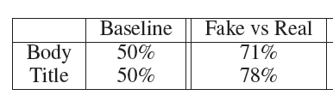
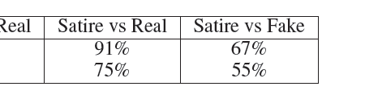
Model Comparison
TABLE 10. Horne and Adali (2017) paper results
Horne and Adali (2017) selected the top 4 features using ANOVA and used SVM to distinguish between fake and real news articles. Using only linguistic features, the model had an accuracy of around 70% for the content.

Slide 56
Conclusion
The basic term frequency-based logistic regression model does a fairly good job of distinguishing between fake news and real news.
Adding stylistic features increases both the accuracy and F1 score by up to 2%, a small increase.
The stylistic features do not offer a lot of information that is already contained in the term counts.

Slide 57
Limitations of the Study
Because the dataset is large, the code takes a long time to run.
The study only uses naïve Bayes and logistic regression. Also, the study only tried two variants of each.

Slide 58
Recommendations
Use other features such as lexicon-based features (e.g., number of analytic words, technical words, etc.) or syntactic features (depth of syntax tree) as in Horne and Adali (2017).
Distinguish between hoaxes, propaganda news and satirical news, among others (Rashkin et al., 2017).

